Slide 1
MODULE -3 Data link layer Error detection and correction Mechanism
Dr.S.L.Jayalakshmi,SCOPE,VIT,Chennai

Slide 2
Outline
Types of Errors
Detection
Correction

Slide 3
Types of Errors
Definition of Error
A condition when the receiver’s information does not match with the sender’s information.
During transmission, digital signals suffer from noise that can introduce errors in the binary bits travelling from sender to receiver.
That means a 0 bit may change to 1 or a 1 bit may change to 0.

Slide 4
Types of Errors

Slide 5
Single-bit error
Single bit errors are the least likely type of errors in serial data transmission because the noise must have a very short duration which is very rare.
However this kind of errors can happen in parallel transmission.
ASCII code for STX
ASCII code for LF
Source: Data Communications and Networking – Behrouz A. Forouzan
Notes:
If data is sent at 1Mbps then each bit lasts only 1/1,000,000 sec. or 1 μs.
For a single-bit error to occur, the noise must have a duration of only 1 μs, which is very rare.

Slide 6
Multiple-bit errors
Multiple bit error: If two or more bits are differed between
sending and receiving data stream, then the error is called multiple bit error.
The position of the bits may differ i.e. the bits may not be consecutive.
Here two bits are changed from 0 to 1 and 1 to 0 which leads to two bit difference between the sending and receiving information which is called multiple Bit Error. This type are errors are also common in parallel and serial communication and it leads to some difficulty in detecting and correcting.

Slide 7
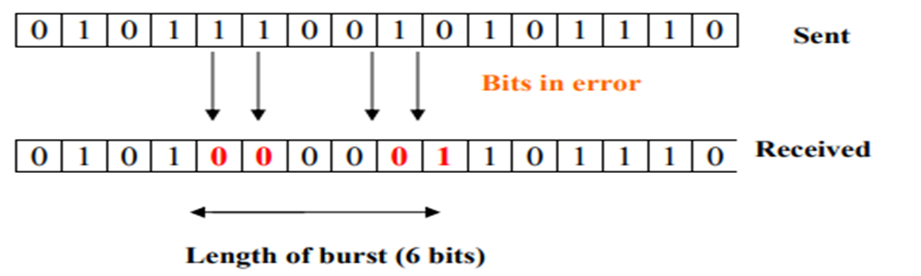
Burst error
Notes:
The term burst error means that two or more bits in the data unit have changed from 1 to 0 or from 0 to 1.
Burst errors does not necessarily mean that the errors occur in consecutive bits, the length of the burst is measured from the first corrupted bit to the last corrupted bit. Some bits in between may not have been corrupted.
Burst error is most likely to happen in serial transmission since the duration of noise is normally longer than the duration of a bit.
The number of bits affected depends on the data rate and duration of noise.
Example:
If data is sent at rate = 1Kbps then a noise of 1/100 sec can affect 10 bits.(1/100*1000)
If same data is sent at rate = 1Mbps then a noise of 1/100 sec can affect 10,000 bits.(1/100*10⁶)

Slide 8
Basic concepts
Networks must be able to transfer data from one device to another with complete accuracy.
Data can be corrupted during transmission.
For reliable communication, errors must be detected and corrected.
Error detection and correction are implemented either at the data link layer or the transport layer of the OSI model.

Slide 9
Error detection
Error detection means to decide whether the received data is correct or not without having a copy of the original message.
Error detection uses the concept of redundancy, which means adding extra bits for detecting errors at the destination.
Notes:
Whenever a message is transmitted, it may get scrambled by noise or data may get corrupted. To avoid this, we use error-detecting codes which are additional data added to a given digital message to help us detect if any error has occurred during transmission of the message.
Basic approach used for error detection is the use of redundancy bits, where additional bits are added to facilitate detection of errors.
Some popular techniques for error detection are: 1. Simple Parity check 2. Two-dimensional Parity check 3. Checksum 4. Cyclic redundancy check

Slide 10
Handling errors
By Detecting
By Correcting

Slide 11
To detect
We need some extra information, to check whether the data is correct or not.

Slide 12
To detect
We need some extra information, to check weather the data is correct or not.
EXTRA → Redundant information

Slide 13
Detection Versus Correction
Which is difficult

Slide 14
Detection Versus Correction
Which is difficult?
How to correct (broad categories)
Forward Error Correction (Hamming code)
Backward Error Correction (Retransmission )

Slide 15
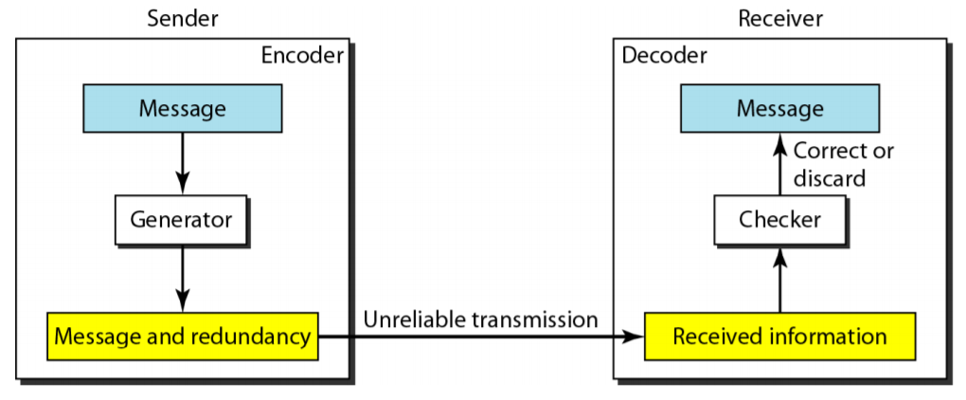
Detection

Slide 16
Detection

Slide 17
Detection

Slide 18
Detection

Slide 19
Detection

Slide 20
Detection
Redundant Data
Code
Relationship between data and code

Slide 21
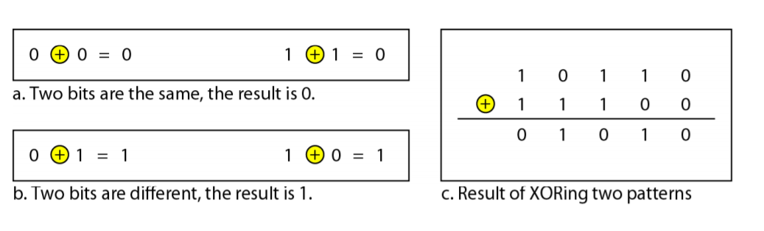
Modulo 2

Slide 22
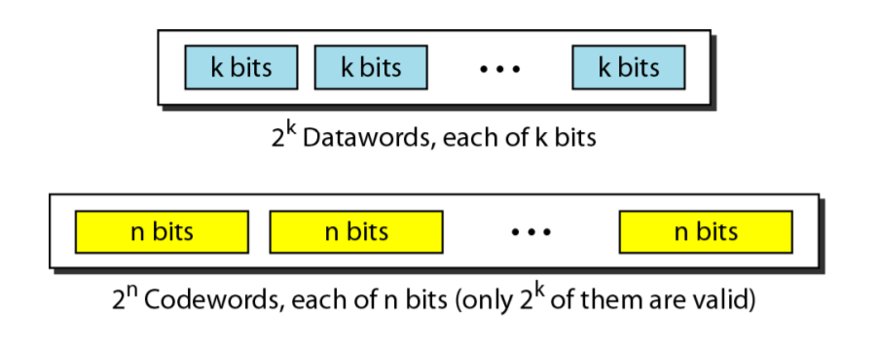
BLOCK CODING

Slide 23
BLOCK CODING

Slide 24
BLOCK CODING
n = k + r

Slide 25
BLOCK CODING
n = k + r

Slide 26
BLOCK CODING

Slide 27
BLOCK CODING
We divide our message into blocks, each of k bits
Add r redundant bits to each block to make the length n = k + r

Slide 28
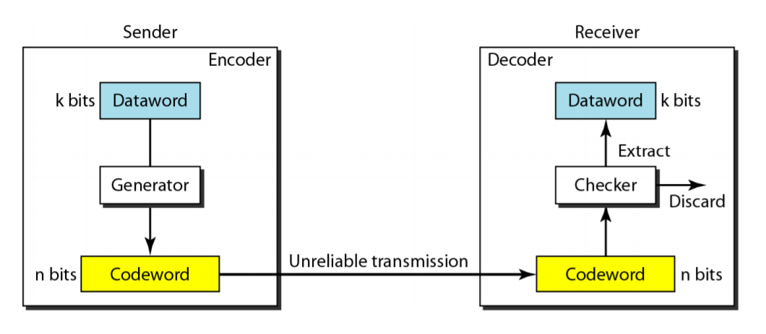
Process of error detection in block coding

Slide 29
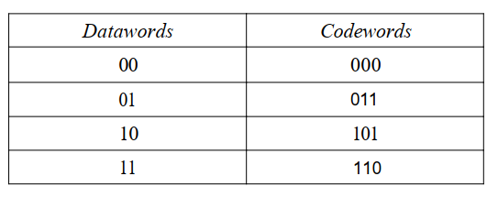
BLOCK CODING
Valid and Invalid code

Slide 30
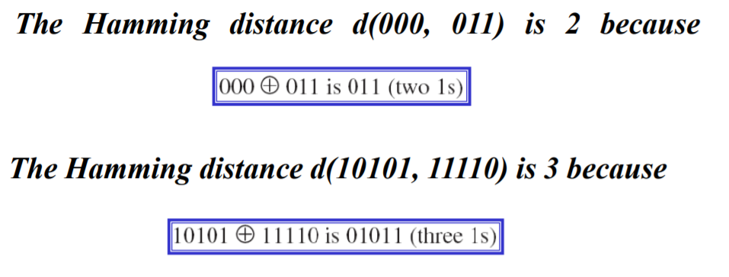
Hamming Distance
The Hamming distance between two words is the number of differences between corresponding bits.

Slide 31
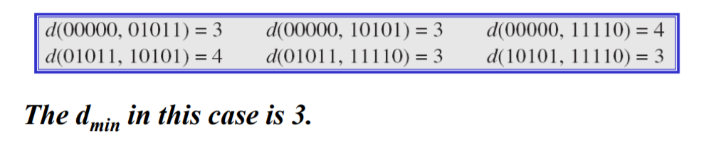
Hamming Distance
The minimum Hamming distance is the smallest Hamming distance between all possible pairs in a set of words.

Slide 32
Hamming Distance

Slide 33
Hamming Distance
To guarantee the detection of up to s errors in all the cases, the minimum Hamming distance in a block code must be dmin = s + 1.

Slide 34
Linear Block Codes
A linear block code is a code in which the exclusive OR (addition modulo-2) of two valid codewords creates another valid codeword

Slide 35
Four types of redundancy checks are used
in data communications
Some popular techniques for error detection are: 1. Simple Parity check- VRC,LRC 2. Two-dimensional Parity check- VRC+LRC 3. Checksum 4. Cyclic redundancy check
VRC- Vertical Redundancy Check
LRC- Longitudinal Redundancy Check
CRC-Cyclic Redundancy Check

Slide 36
Redundancy

Slide 37
Vertical Redundancy Check
VRC
Notes:
In VRC, a parity bit is added to every data unit so that the total number of 1s becomes even (Even parity check).
Some systems may use odd-parity checking, Where the number of 1s should be odd.
Simple parity check
Blocks of data from the source are subjected to a check bit or parity bit generator form, where a parity of :
1 is added to the block if it contains odd number of 1’s, and
0 is added if it contains even number of 1’s
This scheme makes the total number of 1’s even, that is why it is called even parity checking.

Slide 38
Performance
It can detect single bit error
It can detect burst errors only if the total number of errors is odd.
E.g:1000111011-if any three bits change (1111111011), the resulting parity will be odd and the error will be detected.
If it is 1011111011.then what will happen?-will not detect the error(Drawback of VRC).
Note: Blue color text indicates parity check bit
Red color text indicates corrupted bits

Slide 39
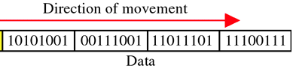
Longitudinal Redundancy Check(LRC)
10101001
00111001
11011101
11100111
10101010-LRC
DATA
Notes:
A block of bits organized in a table (rows and columns).In LRC, a block of bits is divided into rows and redundant row of bits is added to the whole block.

Slide 40
Performance
LRC increases the likelihood of detecting burst errors.
If two bits in one data units are damaged and two bits in exactly the same positions in another data unit are also damaged, the LRC checker will not detect an error.
Eg1: Consider 11110000 and 11000011,if the first and last bits in each of them are changed, making the data units read 01110001 and 01000010
01110001
01000010
00110011

Slide 41
Two-dimensional Parity check
Parity check bits are calculated for each row, which is equivalent to a simple parity check bit.
Parity check bits are also calculated for all columns, then both are sent along with the data.
At the receiving end these are compared with the parity bits calculated on the received data.

Slide 42
VRC and LRC

Slide 43
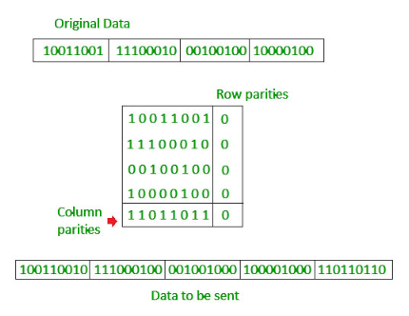
VRC values
LRC values
Row Parity bit is calculated from the LRC block
0

Slide 44
Checksum

Slide 45
At the sender
The unit is divided into k sections, each of n bits.
All sections are added together to get the sum.
The sum is complemented and becomes the checksum.
The checksum is sent with the data

Slide 46
At the receiver
The unit is divided into k sections, each of n bits.
All sections are added together to get the sum.
The sum is complemented.
If the result is zero, the data are accepted: otherwise, they are rejected.

Slide 47
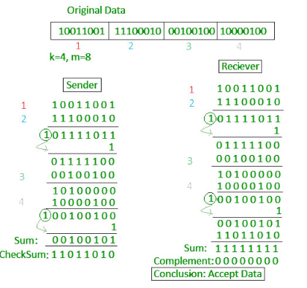

Slide 48
Performance
The checksum detects all errors involving an odd number of bits.
It detects most errors involving an even number of bits.
If one or more bits of a segment are damaged and the corresponding bit or bits of opposite value in a second segment are also damaged, the sums of those columns will not change and the receiver will not detect a problem.

Slide 49
Cyclic redundancy check (CRC)
Unlike checksum scheme, which is based on binary addition, CRC is based on binary division.
In CRC, a sequence of redundant bits, called cyclic redundancy check bits, are appended to the end of data unit so that the resulting data unit becomes exactly divisible by a second, predetermined binary number.
At the destination, the incoming data unit is divided by the same number. If at this step there is no remainder, the data unit is assumed to be correct and is therefore accepted.
A remainder indicates that the data unit has been damaged in transit and therefore must be rejected.

Slide 50
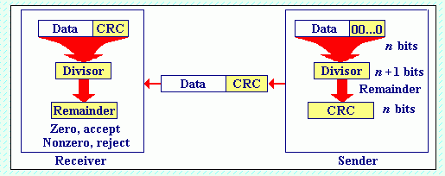

Slide 51
Cyclic Redundancy Check
Given a k-bit frame or message, the transmitter generates an n-bit sequence, known as a frame check sequence (FCS), so that the resulting frame, consisting of (k+n) bits, is exactly divisible by some predetermined number.
The receiver then divides the incoming frame by the same number and, if there is no remainder, assumes that there was no error.

Slide 52
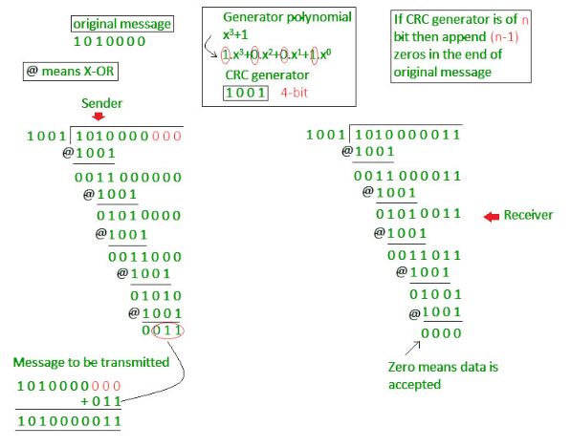

Slide 53
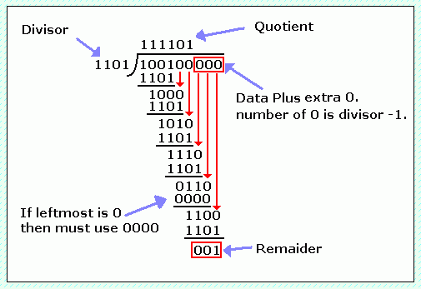
Binary Division

Slide 54
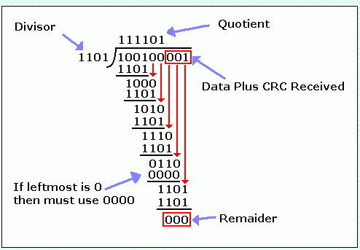

Slide 55
Performance
CRC can detect all burst errors that affect an odd number of bits
CRC can detect all burst errors of length less than or equal to the degree of the polynomial.
CRC can detect with a very high probability burst errors of length greater than the degree of the polynomial.

Slide 56
Polynomial

Slide 57
Polynomial and Divisor

Slide 58
Standard Polynomials

Slide 59
Questions for practice
1) Calculate the VRC and LRC for the following bit pattern using even parity:
← 0011101 1100111 1111111 0000000
2) A sender sends 01110001; the receiver receives 01000001.If only VRC is used, can the receiver detect the error?
3) Suppose that the sender wants to send a word “network”. How it ensures the reliable transmission by applying checksum and two dimensional parity check(even parity) for error detection.
4)Given a remainder of 111, a data unit of 10110011, and a divisor of 1001,is there an error in the data unit?
5)Given the generator function G(x) = x⁴ + x + 1 and the message function
M(x) = x⁷ + x⁶ + x⁴ + x² + x:
Calculate the transmission function T(x).
Consider that the transmission is damaged,
such that the receiver receives R(x) = x¹¹ + x⁹ + x⁸ + x⁷ + x³ + x² + x + 1.
How this error will be detected?

Slide 60
Error Correction
It can be handled in two ways:
receiver can have the sender retransmit the entire data unit.
The receiver can use an error-correcting code, which automatically corrects certain errors.

Slide 61
Single-bit error correction
To correct an error, the receiver reverses the value of the altered bit. To do so, it must know which bit is in error.
Number of redundancy bits needed to correct the error in the original data
Let data bits = m =7
Redundancy bits = r=4
∴Total message sent = m+r=11
The value of r must satisfy the following relation:
2^{r} ≥ m+r+1 16>=12

Slide 62
Error Correction

Slide 63
Hamming Code
Source: Data Communications and Networking – Behrouz A. Forouzan

Slide 64
Hamming Code

Slide 65
Hamming Code

Slide 66
Example of Hamming Code

Slide 67
Single-bit error

Slide 68
Error
Correction
and detection

